Slide 1

Python Advanced
Course Introduction
SoftUni Team
Technical Trainers
Software University
https://softuni.bg/

Slide 2
Table of Contents
Course Objectives
Training and Team
Course Organization
Course Infrastructure
Evaluation Criteria
2

Slide 3
Have a Question?
sli.do
#python-advanced

Slide 4











SoftUni Diamond Partners
4
4

Slide 5



Educational Partners

Slide 6

Course Objectives

Slide 7
Python Advanced Objectives
Working with Lists as Stacks and Queues
Working with Tuples and Sets
Creating and working with Multidimensional Lists
Learning functional programming
Working with Files
Handling Exceptions
7

Slide 8
Practical Programming Exam
Exam – 4 hours
3 practical problems
Stacks and Queues
Multidimensional Lists
Functions
8

Slide 9
Theoretical Exam
You will have 30 minutes once you enter
Multiple-choice with 1 correct answer
Test will be in English
Automated quiz system
Available on the day of the practical exam
You can submit your answers just one time
9

Slide 10

The Team

Slide 11
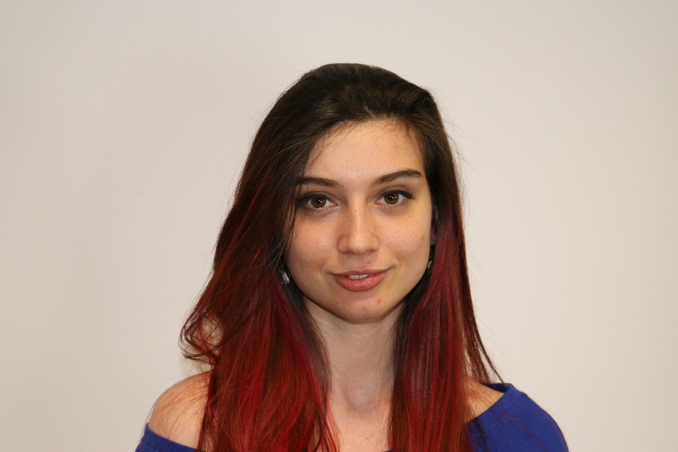
Ines Ivanova
Python Software Engineer at IQVIA
Full stack freelance developer
Python, Django
C#, Angular
HTML, CSS
jQuery, Flask, Docker

Slide 12
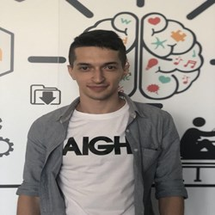
Yavor Lulchev
Part of the IT industry from a 2.5 years
Backend Developer at Uber
Working mostly with Go and Python
Interested in Linux and distributed systems
Occasionally contributes to open source projects

Slide 13

Course Organization

Slide 14
Python Advanced Course
20-May-2021
27-Jun-2021
18-Aug-2021
Python Advanced
5 weeks * 4 times / week
12 credits
Start: 20-May-2021
Theoretical Exam: 27-Jun-2021
Practical Exam: 27-Jun-2021
Re-Take Exams
Theoretical Exam Retake: 18-Aug-2021
Practical Exam Retake: 18-Aug-2021

Slide 15

Homework Assignments & Exercises
Your homework is mainly work in class
Lesson days → slides + live demos + exercises
Exercise days → only exercises
How to submit your homework?
Submitted in the judge system
Do your homework when it's due
Assignments pile up quickly

Slide 16


SoftUni Certificate
Practical Exam 100%
Homework 5%
Evaluation
16

Slide 17
CPE Certificate
Practical Exam
Theoretical Exam
Evaluation
17

Slide 18


Course Web Site, Forum and FB Group
Official web site:
Softuni Python Community group:
https://softuni.bg/trainings/TODO/python-advanced-may-2021
https://www.facebook.com/groups/SoftUniPythonCommunity

Slide 19
Questions?
Notes:
19

Slide 20
Trainings @ Software University (SoftUni)
Software University – High-Quality Education, Profession and Job for Software Developers
softuni.bg, softuni.org
Software University Foundation
softuni.foundation
Software University @ Facebook
facebook.com/SoftwareUniversity
Software University Forums
forum.softuni.bg
20
Notes:
20

Slide 21

License
This course (slides, examples, demos, exercises, homework, documents, videos and other assets) is copyrighted content
Unauthorized copy, reproduction or use is illegal
© SoftUni – https://about.softuni.bg
© Software University – https://softuni.bg
Notes:
21

